Slide 1
Full Stack Application Development
Week 9
GraphDB
Notes:
Welcome to Lecture 2
Things to note:
Module Guide has been updated with amendments to schedule

Slide 2
Graphs and Graph Databases Comparison with RDBMS E-R Model Schema to Graph Neo4J and Cypher Case Study
Graph Databases
Notes:
Welcome to Lecture 2
Things to note:
Module Guide has been updated with amendments to schedule

Slide 3
Graphs consist of two basic components
Graphs – A reminder?
Edges or Arcs
Nodes
Notes:
Welcome to Lecture 2
Things to note:
Module Guide has been updated with amendments to schedule

Slide 4
Graphs are built when …
Graphs – A reminder?
Edges connect Nodes
Notes:
Welcome to Lecture 2
Things to note:
Module Guide has been updated with amendments to schedule

Slide 5
Graphs connect individual data items
Graphs – A reminder?
Nodes can represent different data items
Lecturer
Module
Notes:
Welcome to Lecture 2
Things to note:
Module Guide has been updated with amendments to schedule

Slide 6
Graphs can be simple…
Graphs – A reminder?
Notes:
Welcome to Lecture 2
Things to note:
Module Guide has been updated with amendments to schedule

Slide 7
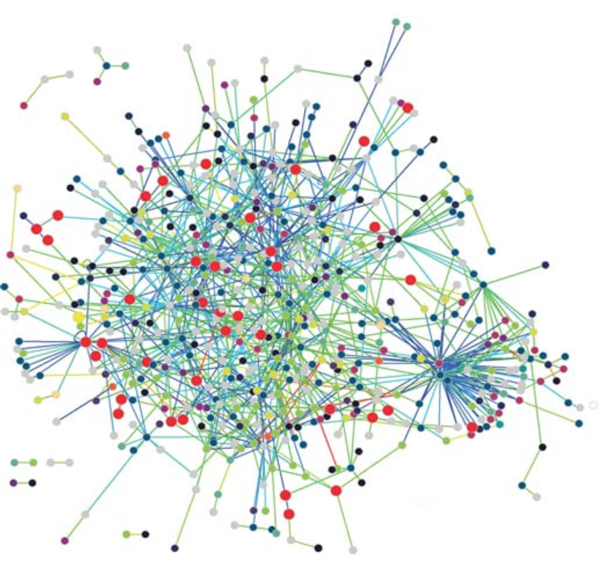
Graphs can be complex …
Graphs – A reminder?
Notes:
Welcome to Lecture 2
Things to note:
Module Guide has been updated with amendments to schedule

Slide 8
A database management system Utilises a graph data model Built around direct relationships between objects (not entities)
Graph Database
Notes:
Welcome to Lecture 2
Things to note:
Module Guide has been updated with amendments to schedule

Slide 9
RDBMS relationships between entities (collections of objects) GRAPH relationships between individual objects
RDBMS vs GRAPH
Notes:
Welcome to Lecture 2
Things to note:
Module Guide has been updated with amendments to schedule

Slide 10
Evolution in data use Increases in: Volume Veracity Velocity Complexity Variety Connectedness
SQL Strain and Pain
Notes:
Welcome to Lecture 2
Things to note:
Module Guide has been updated with amendments to schedule

Slide 11
RDBMS designed for Tabular data Consistent Structure Fixed Schema Despite their name, relational databases do not store relationships between data elements; they are not well suited for today’s highly connected data.
SQL Strain and Pain
Notes:
Welcome to Lecture 2
Things to note:
Module Guide has been updated with amendments to schedule

Slide 12
Data characterisation Densely connected Semi-structured Volatile
SQL Strain and Pain
Notes:
Welcome to Lecture 2
Things to note:
Module Guide has been updated with amendments to schedule

Slide 13
Incompatibility of RDBMS Don’t adapt well to change Inflexible Time consuming
SQL Strain and Pain
Notes:
Welcome to Lecture 2
Things to note:
Module Guide has been updated with amendments to schedule

Slide 14
Signs of SQL Strain JOINS of multiple tables Numerous recursive JOINS Schema alterations Need to denormalise Precomputation necessity
SQL Strain and Pain
Notes:
Welcome to Lecture 2
Things to note:
Module Guide has been updated with amendments to schedule

Slide 15
Signs of SQL Strain Indicates need of a new approach Considerations
SQL Strain and Pain
Data model indicates high number of data relationships
Flexibility to expand model for new data or relationships
Query cost
Notes:
Welcome to Lecture 2
Things to note:
Module Guide has been updated with amendments to schedule

Slide 16
For a schema installed in an RDBMS Conceptual → Logical → Physical At each stage tighter more rigid constraint
Data Modelling - RDBMS
Notes:
Welcome to Lecture 2
Things to note:
Module Guide has been updated with amendments to schedule

Slide 17
Conceptual Modelling generally starts with “whiteboarding” With a Graph Database, whiteboard design can be expressed directly from the circles and lines drawn
Data Modelling - Graph
Notes:
Welcome to Lecture 2
Things to note:
Module Guide has been updated with amendments to schedule

Slide 18
An RDBMS query requires re-joining normalised tables to identify relationships between data items All objects in entities must be considered
Querying – RDBMS
Notes:
Welcome to Lecture 2
Things to note:
Module Guide has been updated with amendments to schedule

Slide 19
Structure of relationships, limits the data items accessed. Queries constructed in graph traversal expressive language
Querying – Graph
Notes:
Welcome to Lecture 2
Things to note:
Module Guide has been updated with amendments to schedule

Slide 20
Data increase requires increased data manipulation, JOINS and Index maintenance. Trade off – use of inconsistent data
Query Performance – RDBMS
Notes:
Welcome to Lecture 2
Things to note:
Module Guide has been updated with amendments to schedule

Slide 21
Relationships stored at insertion Data localised by direct connection Single index to locate start point, the traverse
Querying Performance – Graph
Notes:
Welcome to Lecture 2
Things to note:
Module Guide has been updated with amendments to schedule

Slide 22
Contractors Database Concept - Whiteboard RDBMS Graph
Simple on Board Design example
Company/Project
Contract
Contractor
Notes:
Welcome to Lecture 2
Things to note:
Module Guide has been updated with amendments to schedule

Slide 23
SELECT Person.Name FROM Person, Contract, Company WHERE Company.Name = ‘IBM’ AND Contract.PID = Person.PID AND Contract.CID = Company.CID ;
Relational to Graph
Contract
CID | PID | Date | For
2 | 1 | 03.04.17 | 6 m
1 | 1 | 08.01.18 | 2 y
2 | 3 | 03.04.17 | 9 m
3 | 2 | 06.01.18 | 1 y
2 | 3 | 03.04.18 | 6 m
… | … | … | …
n | … | … | …
Company
Person
CID | Name
1 | Oracle
2 | IBM
3 | Amazon
… | …
n | …
PID | Name
1 | Mike Long
2 | Kai Lang
3 | Si Wilson
… | …
n | …
Search for Person by Name attached to Company by name
Notes:
Welcome to Lecture 2
Things to note:
Module Guide has been updated with amendments to schedule

Slide 24
SELECT Person.Name FROM Person, Contract, Company WHERE Company.Name = ‘IBM’ AND Contract.PID = Person.PID AND Contract.CID = Company.CID ;
Relational to Graph
Contract
CID | PID | Date | For
2 | 1 | 03.04.17 | 6 m
1 | 1 | 08.01.18 | 2 y
2 | 3 | 03.04.17 | 9 m
3 | 2 | 06.01.18 | 1 y
2 | 3 | 03.04.18 | 6 m
… | … | … | …
n | … | … | …
Company
Person
CID | Name
1 | Oracle
2 | IBM
3 | Amazon
… | …
n | …
PID | Name
1 | Mike Long
2 | Kai Lang
3 | Si Wilson
… | …
n | …
Index Lookup 1
Notes:
Welcome to Lecture 2
Things to note:
Module Guide has been updated with amendments to schedule

Slide 25
SELECT Person.Name FROM Person, Contract, Company WHERE Company.Name = ‘IBM’ AND Company.CID = Contract.CID AND Contract.PID = Person.PID ;
Relational to Graph
Contract
CID | PID | Date | For
2 | 1 | 03.04.17 | 6 m
1 | 1 | 08.01.18 | 2 y
2 | 3 | 03.04.17 | 9 m
3 | 2 | 06.01.18 | 1 y
2 | 3 | 03.04.18 | 6 m
… | … | … | …
n | … | … | …
Company
Person
CID | Name
1 | Oracle
2 | IBM
3 | Amazon
… | …
n | …
PID | Name
1 | Mike Long
2 | Kai Lang
3 | Si Wilson
… | …
n | …
Index Lookup 2 (FK)
Notes:
Welcome to Lecture 2
Things to note:
Module Guide has been updated with amendments to schedule

Slide 26
SELECT Person.Name FROM Person, Contract, Company WHERE Company.Name = ‘IBM’ AND Company.CID = Contract.CID AND Contract.PID = Person.PID ;
Relational to Graph
Contract
CID | PID | Date | For
2 | 1 | 03.04.17 | 6 m
1 | 1 | 08.01.18 | 2 y
2 | 3 | 03.04.17 | 9 m
3 | 2 | 06.01.18 | 1 y
2 | 3 | 03.04.18 | 6 m
… | … | … | …
n | … | … | …
Company
Person
CID | Name
1 | Oracle
2 | IBM
3 | Amazon
… | …
n | …
PID | Name
1 | Mike Long
2 | Kai Lang
3 | Si Wilson
… | …
n | …
Index Lookup 3 (FK)
Notes:
Welcome to Lecture 2
Things to note:
Module Guide has been updated with amendments to schedule

Slide 27
Relational to Graph
Person
Company
PID:1
Mike Long
CID:1
Oracle
Contracted to
Contracted to
Company
Person
CID:2
IBM
PID:2
Kai Lang
Contracted to
Person
Contracted to
Company
PID:3
Si Wilson
CID:3
Amazon
Contracted to
Notes:
Welcome to Lecture 2
Things to note:
Module Guide has been updated with amendments to schedule

Slide 28
Relational to Graph
Person
CID:1
Oracle
Company
PID:1
Mike Long
Contracted to
Contracted to
Company
Person
PID:2
Kai Lang
CID:2
IBM
Contracted to
Contracted to
Person
PID:3
Si Wilson
Contracted to
CID:3
Amazon
Company
MATCH (:Company {name: 'IBM'})<-[Contracted_to]-(n)
RETURN n
Notes:
Welcome to Lecture 2
Things to note:
Module Guide has been updated with amendments to schedule

Slide 29
Relational to Graph
Person
CID:1
Oracle
Company
PID:1
Mike Long
Contracted to
Contracted to
Company
Person
PID:2
Kai Lang
CID:2
IBM
Contracted to
Contracted to
Person
PID:3
Si Wilson
Contracted to
CID:3
Amazon
Company
Index Lookup
MATCH (Company {name: 'IBM'})<-[Contracted_to]-(n)
RETURN n
Notes:
Welcome to Lecture 2
Things to note:
Module Guide has been updated with amendments to schedule

Slide 30
Relational to Graph
Person
CID:1
Oracle
Company
PID:1
Mike Long
Contracted to
Contracted to
Company
Person
PID:2
Kai Lang
CID:2
IBM
Contracted to
Contracted to
Person
PID:3
Si Wilson
Contracted to
CID:3
Amazon
Company
Traverse Relation
MATCH (Company {name: 'IBM'})<-[Contracted_to]-(n)
RETURN n
Notes:
Welcome to Lecture 2
Things to note:
Module Guide has been updated with amendments to schedule

Slide 31
Relational to Graph
Consider the following ERD
Guide
Outing
Location
Booking
Client
Tour
Itinerary
Notes:
Welcome to Lecture 2
Things to note:
Module Guide has been updated with amendments to schedule

Slide 32
Relational to Graph
Attributes
Guide – Name, Address, Hire Date
Tour – Name, Duration, Cost
Outing – Name*, Date, Guide*
Location – Name, Type, Description
Itinerary Item – Tour*, Location*, Order_Visited_No
Client – Name, Phone_No
Booking – Client*, Outing*, Discount%, IsPaid
Guide
Outing
Location
Booking
Client
Tour
Itinerary
Notes:
Welcome to Lecture 2
Things to note:
Module Guide has been updated with amendments to schedule

Slide 33
Relational to Graph
How do we represent this using a graph model?
Guide
Outing
Location
Booking
Client
Tour
Itinerary
Notes:
Welcome to Lecture 2
Things to note:
Module Guide has been updated with amendments to schedule

Slide 34
Relational to Graph
Booking is a link or hidden entity – reinstate the M-M
Guide
Outing
Location
Client
Tour
Itinerary
Notes:
Welcome to Lecture 2
Things to note:
Module Guide has been updated with amendments to schedule

Slide 35
Relational to Graph
Itinary is a link or hidden entity – reinstate that M-M
Guide
Outing
Location
Client
Tour
Notes:
Welcome to Lecture 2
Things to note:
Module Guide has been updated with amendments to schedule

Slide 36
Relational to Graph
Outing is a weak entity – it remains
Guide
Outing
Location
Client
Tour
Notes:
Welcome to Lecture 2
Things to note:
Module Guide has been updated with amendments to schedule

Slide 37
Relational to Graph
Convert to graph format
Outing
Guide
Leads
Location
Books on
Instance of
Visits
Client
Tour
Notes:
Welcome to Lecture 2
Things to note:
Module Guide has been updated with amendments to schedule

Slide 38
Relational to Graph
Attributes from entities remaining before conversion …
Outing
Guide
Leads
Location
Books on
Instance of
Visits
Client
Tour
… are converted to node properties
Notes:
Welcome to Lecture 2
Things to note:
Module Guide has been updated with amendments to schedule

Slide 39
Relational to Graph
Attributes
(:Guide { Name: 'Mark',
Address: 'Hatfield',
Hire_Date: date({ year:1979, month:4, day:21 })})
(:Tour { Name: 'London Highlights',
Duration: 2,
Cost: 35.50 })
(:Outing { Date: date({ year:2019, month:12, day:17 })})
(:Location { Name: 'Tower Bridge',
Type: 'Building',
Description: 'Iconic lifting bridge … '})
(:Client { Name: 'Louise',
Type: '082487291274'})
Notes:
Welcome to Lecture 2
Things to note:
Module Guide has been updated with amendments to schedule

Slide 40
Relational to Graph
Attributes from entities removed before conversion …
Outing
Guide
Leads
Location
Books on
Instance of
Visits
Client
Tour
… are converted to relationship properties
Notes:
Welcome to Lecture 2
Things to note:
Module Guide has been updated with amendments to schedule

Slide 41
Relational to Graph
Attributes
-[:Itinerary { Order_Visited_No: 1}]->
-[:Booking { Discount: 10, Paid: ‘Y'}]->
Notes:
Welcome to Lecture 2
Things to note:
Module Guide has been updated with amendments to schedule

Slide 42
Neo4J graph query language Heavily based on node and relationship patterns Uses pattern recognition, a fundamental way to human brain works
CYPHER
Notes:
Welcome to Lecture 2
Things to note:
Module Guide has been updated with amendments to schedule

Slide 43
Nodes are represented by round brackets ( ) is a representation of a
CYPHER
Node
Notes:
Welcome to Lecture 2
Things to note:
Module Guide has been updated with amendments to schedule

Slide 44
Relationships are represented by labelled arrows -[:Relates_to]-> is a representation of an edge
CYPHER
Relates_To
Notes:
Welcome to Lecture 2
Things to note:
Module Guide has been updated with amendments to schedule

Slide 45
Representing Nodes () Anonymous Node (:Person) Labelled Node (a:Person) Labelled node assigned to variable
CYPHER
Node
Notes:
Welcome to Lecture 2
Things to note:
Module Guide has been updated with amendments to schedule

Slide 46
Representing Relationships ()-[:LIKES]->() Forward Relationship ()<-[:LIKES]-() Backward Relationship ()-[:LIKES]-() An Undirected Relationship cannot be created in Cypher ()<-[:LIKES]->() A Bidirectional Relationship cannot be created in Cypher
CYPHER
Notes:
Welcome to Lecture 2
Things to note:
Module Guide has been updated with amendments to schedule

Slide 47
Creating Nodes (INSERT) CREATE (:Person {name: 'Mark'}) CREATE (:Car {colour: 'Red', reg_No: 'SN68THW'})
CYPHER - CRUD
Person
Name: Mark
Car
colour: Red
reg_No: SN68THW
Notes:
Welcome to Lecture 2
Things to note:
Module Guide has been updated with amendments to schedule

Slide 48
Creating Relationship CAREFUL !!
CYPHER - CRUD
Person
Name: Mark
Drives
Car
colour: Red
reg_No: SN68THW
Notes:
Welcome to Lecture 2
Things to note:
Module Guide has been updated with amendments to schedule

Slide 49
CYPHER - CRUD
Person
Name: Mark
Car
Drives
colour: Red
reg_No: SN68THW
Already created the Nodes, so DON’T DO THIS
CREATE (:Person {name: 'Mark'})
-[:Drives]->
(:Car {colour: 'Red', reg_No: 'SN68THW'})
Notes:
Welcome to Lecture 2
Things to note:
Module Guide has been updated with amendments to schedule

Slide 50
CYPHER - CRUD
CREATE (:Person {name: 'Mark'})
-[:Drives]->
(:Car {colour: 'Red', reg_No: 'SN68THW'})
Person
Car
colour: Red
reg_No: SN68THW
Name: Mark
Drives
Person
Car
colour: Red
reg_No: SN68THW
Name: Mark
Notes:
Welcome to Lecture 2
Things to note:
Module Guide has been updated with amendments to schedule

Slide 51
CYPHER - CRUD
Person
Name: Mark
Car
Drives
colour: Red
reg_No: SN68THW
MATCH finds existing nodes, assigns to variables
MATCH (p:Person {name: 'Mark'})
MATCH (c:Car {colour: 'Red', reg_No: 'SN68THW'})
CREATE (p)-[:Drives]->(c)
Notes:
Welcome to Lecture 2
Things to note:
Module Guide has been updated with amendments to schedule

Slide 52
CYPHER - CRUD
MATCH (p:Person {name: 'Mark'})
MATCH (c:Car {colour: 'Red', reg_No: 'SN68THW'})
CREATE (p)-[:Drives]->(c)
Person
Name: Mark
Car
Drives
colour: Red
reg_No: SN68THW
MATCH the existing Nodes, assign to variables
CREATE relationship between variables
Notes:
Welcome to Lecture 2
Things to note:
Module Guide has been updated with amendments to schedule

Slide 53
CYPHER - CRUD
Person
Name: Mark
Car
Drives
colour: Blue
reg_No: SN68THW
Also use MATCH to update properties
MATCH (c:Car {reg_No: 'SN68THW'})
SET (c.colour) = 'Blue'
Notes:
Welcome to Lecture 2
Things to note:
Module Guide has been updated with amendments to schedule

Slide 54
CYPHER - CRUD
Person
Name: Mark
Car
Drives
colour: Red
reg_No: SN68THW
DELETE also has to be ordered
Nodes cannot be deleted until they have no relationships with other nodes
Notes:
Welcome to Lecture 2
Things to note:
Module Guide has been updated with amendments to schedule

Slide 55
CYPHER - CRUD
Person
Name: Mark
Car
Drives
colour: Red
reg_No: SN68THW
Delete using MATCH and DELETE
MATCH (p:Person {name: 'Mark'})
-[r:Drives]->
(c:Car {colour: 'Red', reg_No: 'SN68THW'})
DELETE r,p,c
Notes:
Welcome to Lecture 2
Things to note:
Module Guide has been updated with amendments to schedule

Slide 56
CYPHER - CRUD
Person
Name: Mark
Car
Drives
colour: Red
reg_No: SN68THW
Delete using MATCH and DELETE
MATCH (p:Person {name: 'Mark'})
-[r:Drives]->
(c:Car {colour: 'Red', reg_No: 'SN68THW'})
DELETE r,p,c
Notes:
Welcome to Lecture 2
Things to note:
Module Guide has been updated with amendments to schedule

Slide 57
Two important properties
Graph Database
Graph Storage Native, Relational, Object Oriented
Graph Processing Engine
Index-Free Adjacency
Notes:
Welcome to Lecture 2
Things to note:
Module Guide has been updated with amendments to schedule

Slide 58
Reflecting highly connected data in storage model Optimised for graph traversal, via: neighbourhood caching de-referencing
Native Graph Storage
Notes:
Welcome to Lecture 2
Things to note:
Module Guide has been updated with amendments to schedule

Slide 59
Two important properties
Graph Database
Graph Storage Native, Relational, Object Oriented
Graph Processing Engine
Index-Free Adjacency
Notes:
Welcome to Lecture 2
Things to note:
Module Guide has been updated with amendments to schedule

Slide 60
Physical RAM address to all neighbouring nodes No intervening data structures or “indexes” Generated when the relationship is created If node retrieved, directly related nodes stored in cache
Index Free Adjacency
Notes:
Welcome to Lecture 2
Things to note:
Module Guide has been updated with amendments to schedule

Slide 61
Traversal by Pointer Chasing (Basic Fetch-Execute) O(1) Cost > one jump traversals via pointer de-referencing
Index Free Adjacency in neo4j
Notes:
Welcome to Lecture 2
Things to note:
Module Guide has been updated with amendments to schedule

Slide 62
Lab exercises on Canvas
Working with neo4j
Notes:
Welcome to Lecture 2
Things to note:
Module Guide has been updated with amendments to schedule

